Slide 1
Year 10 PreATAR Science
Cell division: DNA replication and mitosis

Slide 2
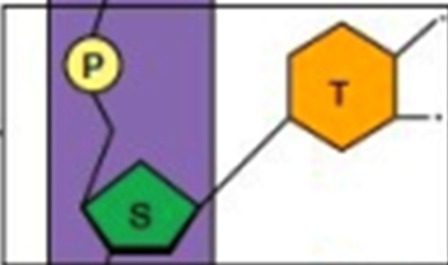
Review
What do P S and T represent?
What are the complimentary base pairs?
How many bases code for an amino acid?
How much data is in the human genome?

Slide 3
Learning Intentions
The transmission of heritable characteristics from one generation to the next involves DNA and genes
describing the role of DNA as the blueprint for controlling the characteristics of organisms
using models and diagrams to represent the relationship between DNA, genes and chromosomes

Slide 4
Success criteria
Explain why DNA replication and mitosis need to occur
State the sequence for mitosis
Summarise the key events in each phase
Identify cells at each stage of mitosis under a microscope

Slide 5
Why would a cell divide?
Growth
Repair or replacement

Slide 6
Cell division
Cells divide to produce two identical copies of themselves by mitosis
IPMAT

Slide 7
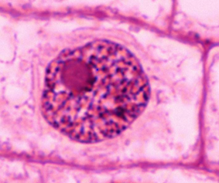
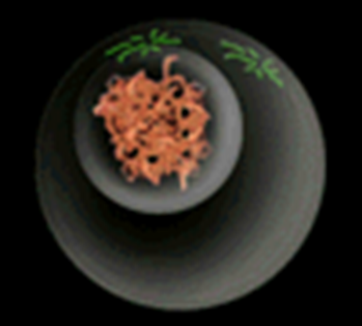
Interphase
Cells spend about 90% of their time in interphase, during which they
absorb nutrients
grow
do their job (make protein)
Duplicate DNA (chromosomes) in preparation for cell duplication

Slide 8
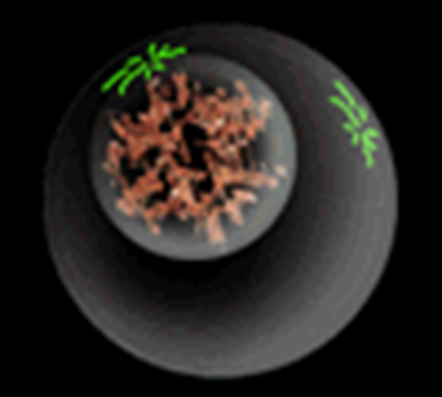
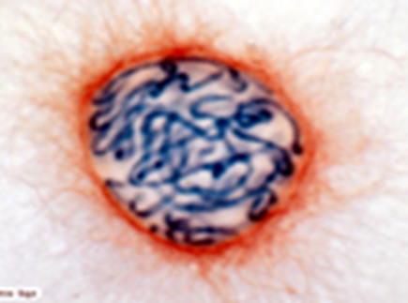
Prophase
DNA condenses into visible chromosomes
Nuclear membrane dissolves
Centrioles migrate to opposite poles and spindle fibres form between them

Slide 9
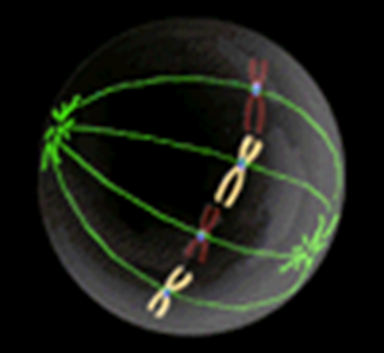
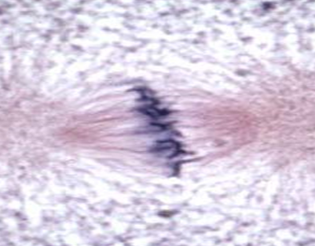
Metaphase
Chromosomes line up along the ‘equator’ of the cell
Centromeres attach to spindle fibres

Slide 10
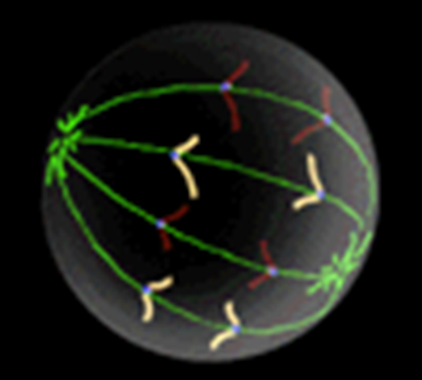
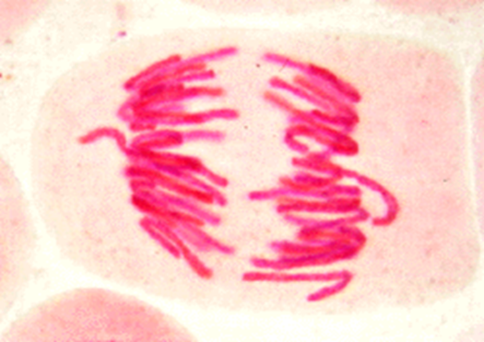
Anaphase
Centromeres divide
Spindle fibres contract
Chromatids are pulled away from one another towards the poles

Slide 11
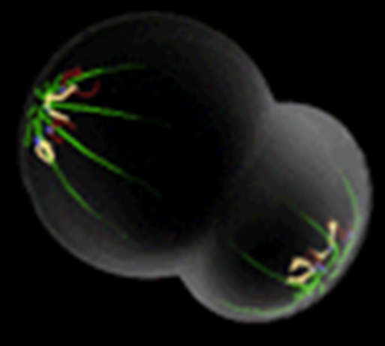
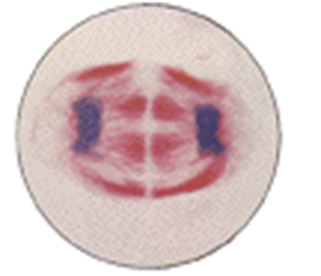
Telophase
Chromosomes reach the poles
Nuclear membranes form around the two new nuclei

Slide 12
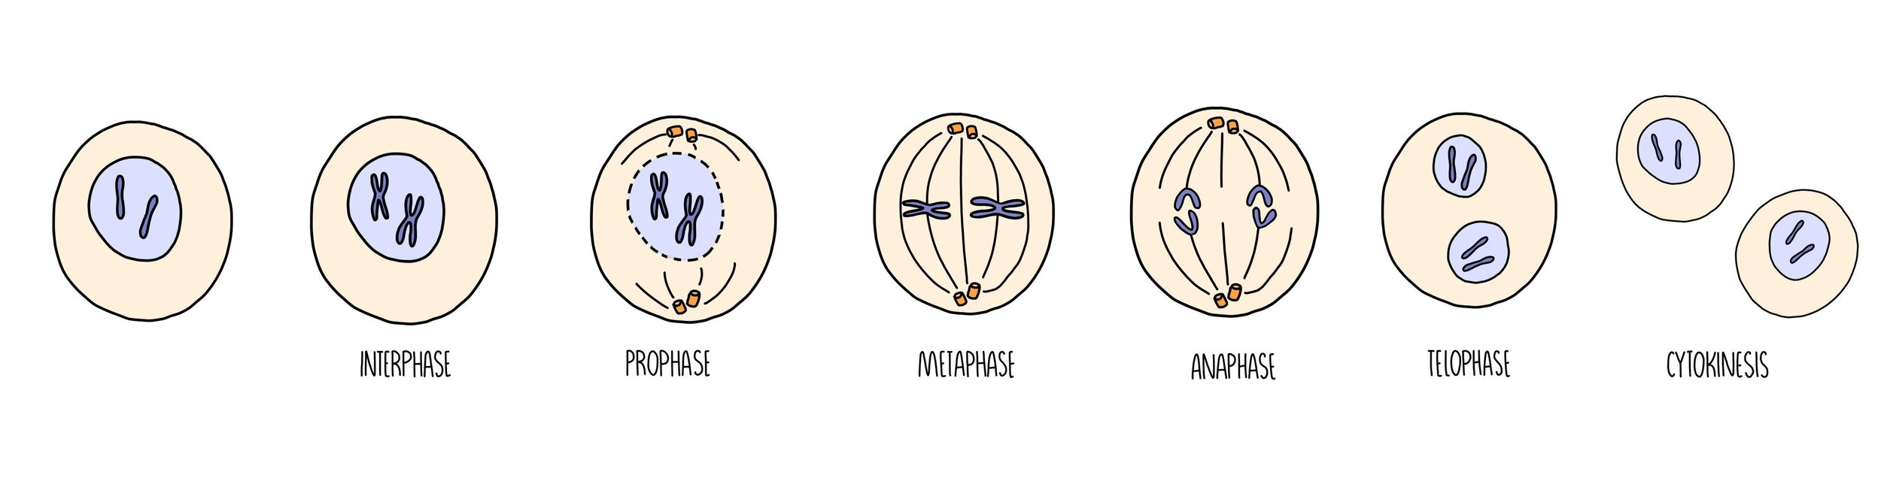
Memory aid- mnemonic

Slide 13
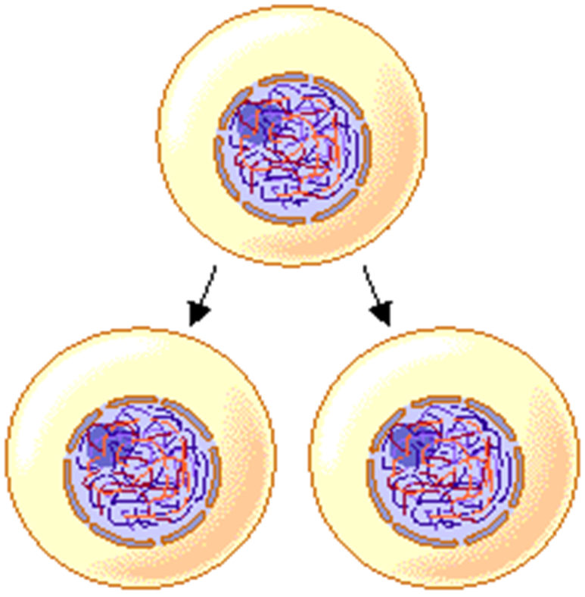
The cells produced by mitosis
Two cells, identical to each other and the original cell.
Contain the diploid
number of chromosomes
(humans 46)
Why is this important?

Slide 14
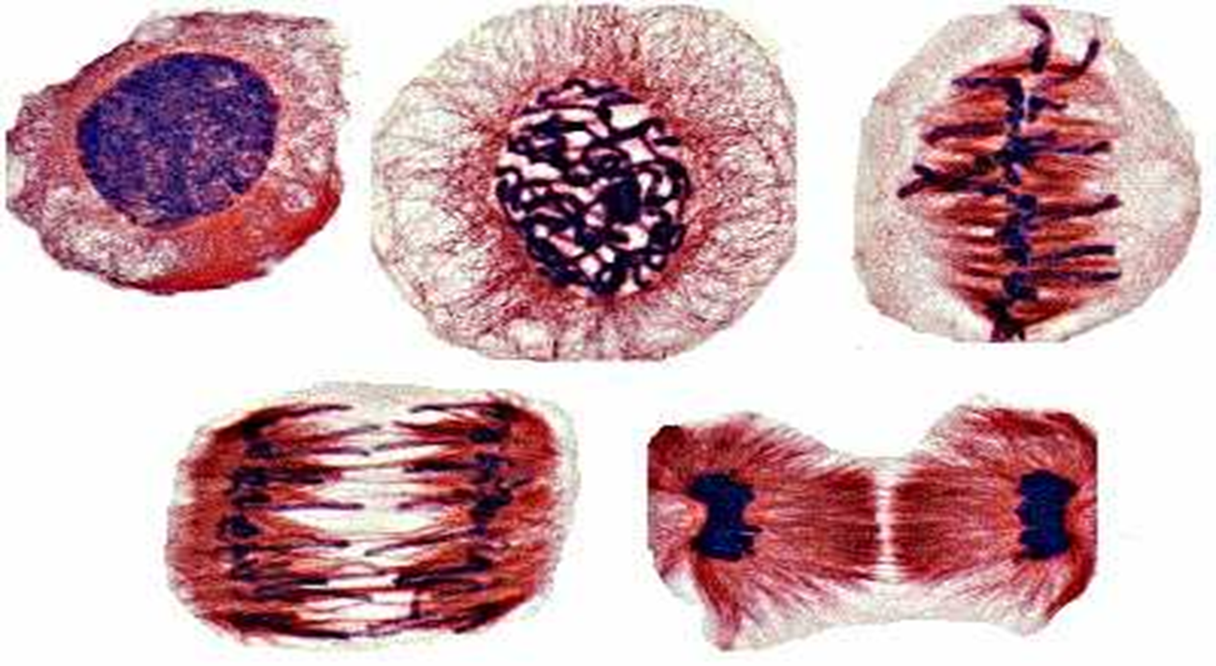

Slide 15
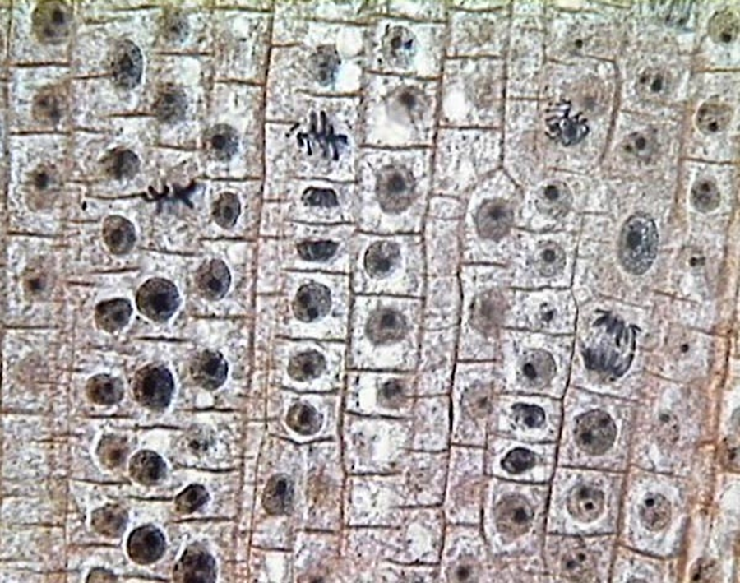

Slide 16
